Slide 2
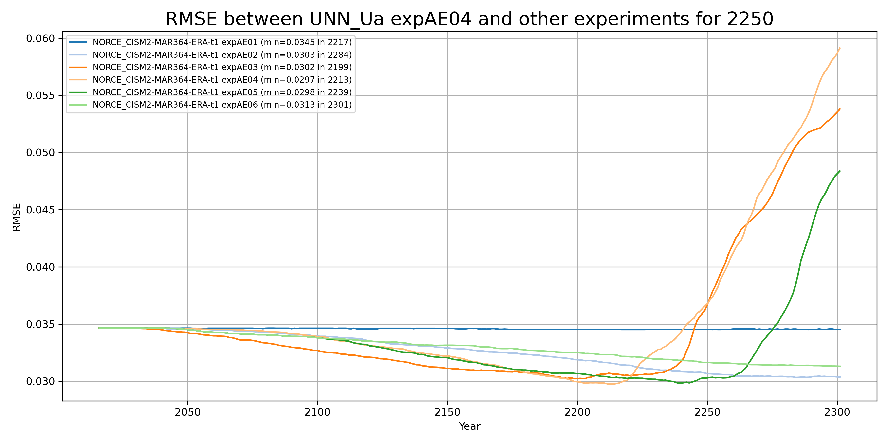
RMSE: target UNN_Uà compared to NORCE
RMSE min:
expAE03
expAE04
expAE05

Slide 3
Diagnostics

Slide 4
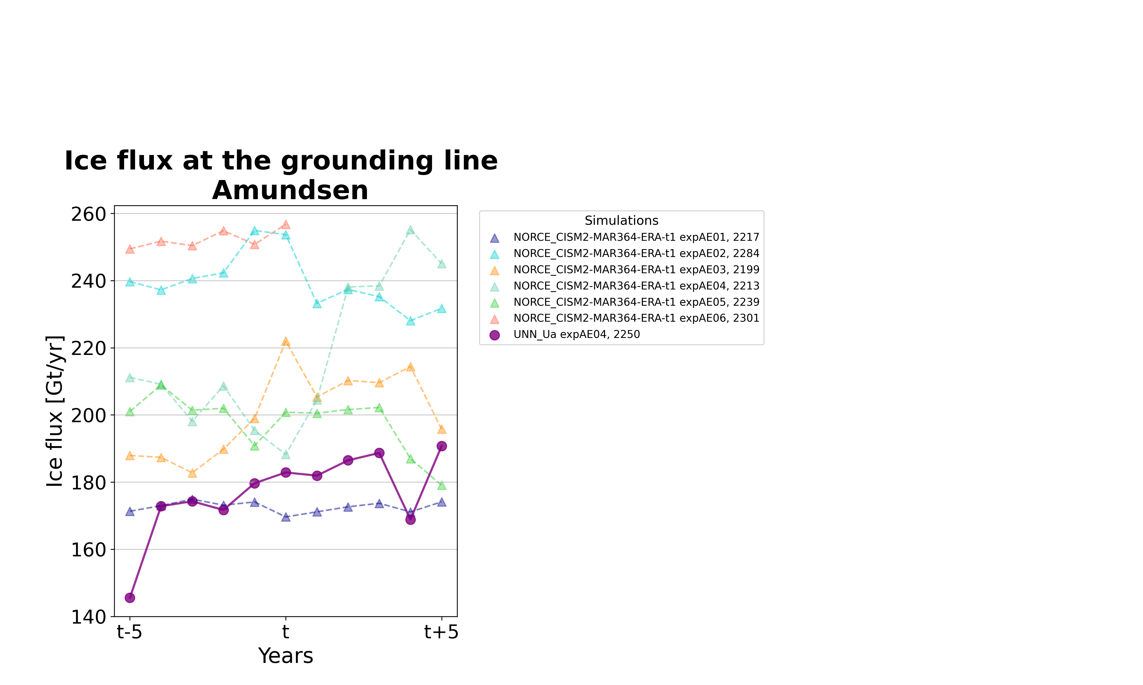
Ice flux at the grounding line

Slide 5
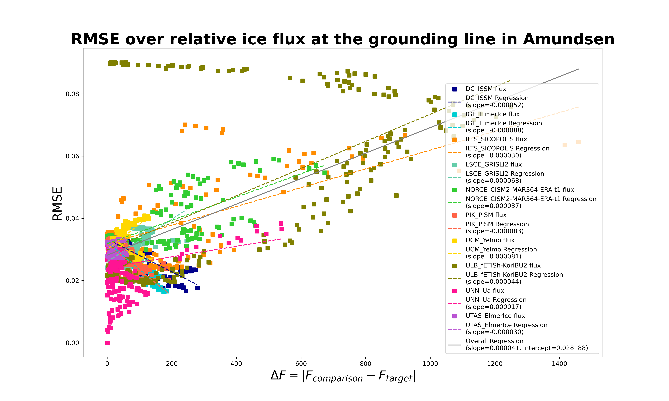
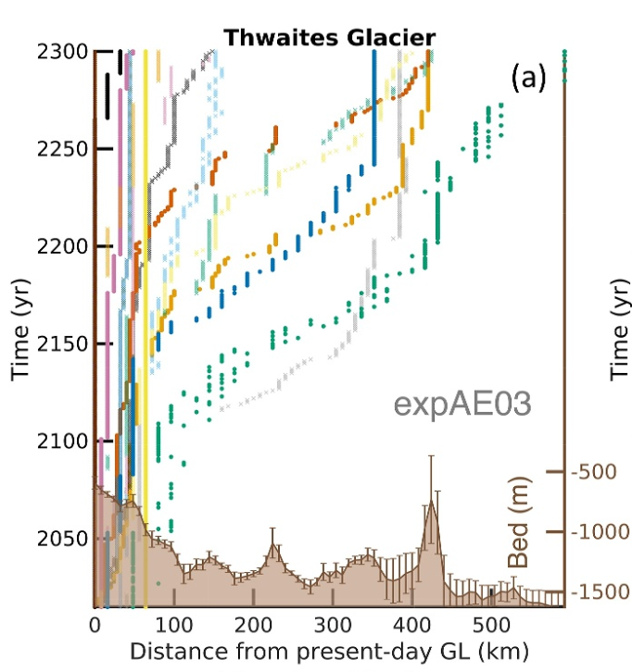
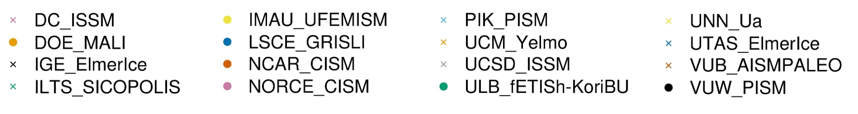
RMSE over absolute relative ice flux
Modified figure from Seroussi 2024, evolution of the relative distance of the grounding line over the time

